Slide 1
TEAM : INNOVATORS
HT
HEALTH TECH
GL BAJAJ MATHURA
TEAM LEADER
TEAMMATE
HIMANSHI GUPTA (CS18033@glbajajgroup.org)
PANKAJ VERMA (pv24aug2001@gmail.com)

Slide 2
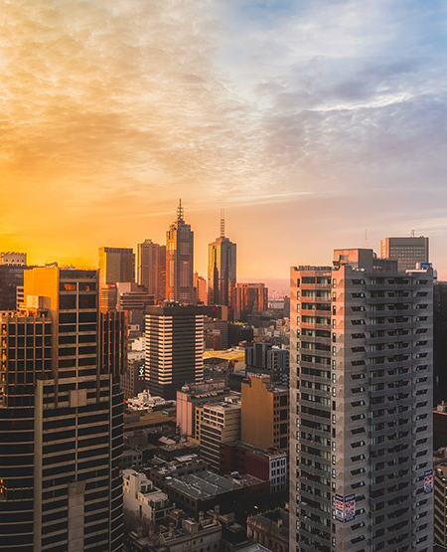
IDEA Need /
Opportunity
Problem Statement :
Create Solutions to deal with these two major challenges faced by the patients:
~ Enabling a patient-centered information exchange system.
~ Personal medical assistant.
Patients can easily interact with each other and can share their experiences and problems together.
Help people to consult with doctors using personal medical assistant facility by sharing their symptoms and get to know the better way to fight back with disease.
Patients need not to go anywhere in this pandemic condition and this ensures their safety from COVID-19.
Unmet need / values fulfil through solution :

Slide 3
Solution / IDEA in a Nutshell
EP
IDEA / SOLUTION
Creating community of patients and trusted doctors as well where they can communicate with each other.
MOTIVE :
Patients of particular disease(category) will be able to share their experiences, problem and success story of getting cured successfully with other patients having same disease(category).
Patients may resolve their queries through AI chat bot(Help box).
Patients would be able to contact their local area doctors on whom they trust blindly.
Providing community of trusted and valid doctors(verifying profile, documents and details of doctors).
Facility for patients to interact with their medical assistant through video call.
Consult with your medical assistant at your home whenever you have time (no need to take appointments and wait in line)..
Patients may get knowledge of other diseases as well by searching it on our portal.
Key Features :
Unique Benefits :
Patients be able to consult with their local area doctors through online and do video call for better consultation and communication.
Patients having same disease may share their experiences and how they cure through that disease.
Know about others diseases by searching them.
Resolving queries through AI chat bot.
Patients feel free to consult with their local area known doctors.
Platform of trusted and verified doctors.
Videocall helps in better communication between doctor and patients
Shared stories and experiences through patients having same disease will help other patients to get motivation, self confidence and faith on doctors that they can also get cured(reduce stress and depression because of disease).

Slide 4
TECHNOLOGY STACK
React Framework.
Image Analysis.
AWS(Hosting the app).
MongoDB(Database).
React web Portal
Chat Bot
Find out diseases based on search
Suggest doctors near you(local area).
Interact with doctor through video call.

Slide 5
Doctor
Login as Doctor
ADD your details(for verification)
Details :
Registered name as doctor.
Education qualification.
Submission of certificates(like MBBS degree).
YOE(years of experience as doctor).
Details of current working place(Hospital or clinic).
Specialisation(in particular disease)
Other details etc.
Get Verified and Authorised Doctor profile

Slide 6
Patients
Login as Patient
Search doctors
Interact with other patients and sharing experiences
Through disease category search
Resolving queries through AI chat bot.
Through location search
(result : profiles of that area’s doctors will be shown)

